Slide 1

peeko.
Unlocking the wisdom of crowds
Peek. Speak. Repeat.

Slide 2

Our Mission
Building communities, one connection at a time.

Slide 3

Our Problem
Pluralistic Ignorance Everyone is willing to talk but thinks everyone else is unwilling.
The Cut¹
Sources available in Appendix

Slide 4





Our Focus
The Average American 5 hours spent each day doing nothing
The Working Professional 55 minutes spent travelling each day
The Millennial 26% do not know their neighbour's first name
CDC²
census.gov³
OnePoll Study⁴
The Disconnected Workspace Social Tech can boost productivity by 25%
The Chasing Loneliness 37% of meals consumed alone not by choice
McKinsey Study⁵
Forbes⁶
Sources available in Appendix

Slide 5




Our Solution
You share your interests.
All through our app.
We connect the conversation.

Slide 6

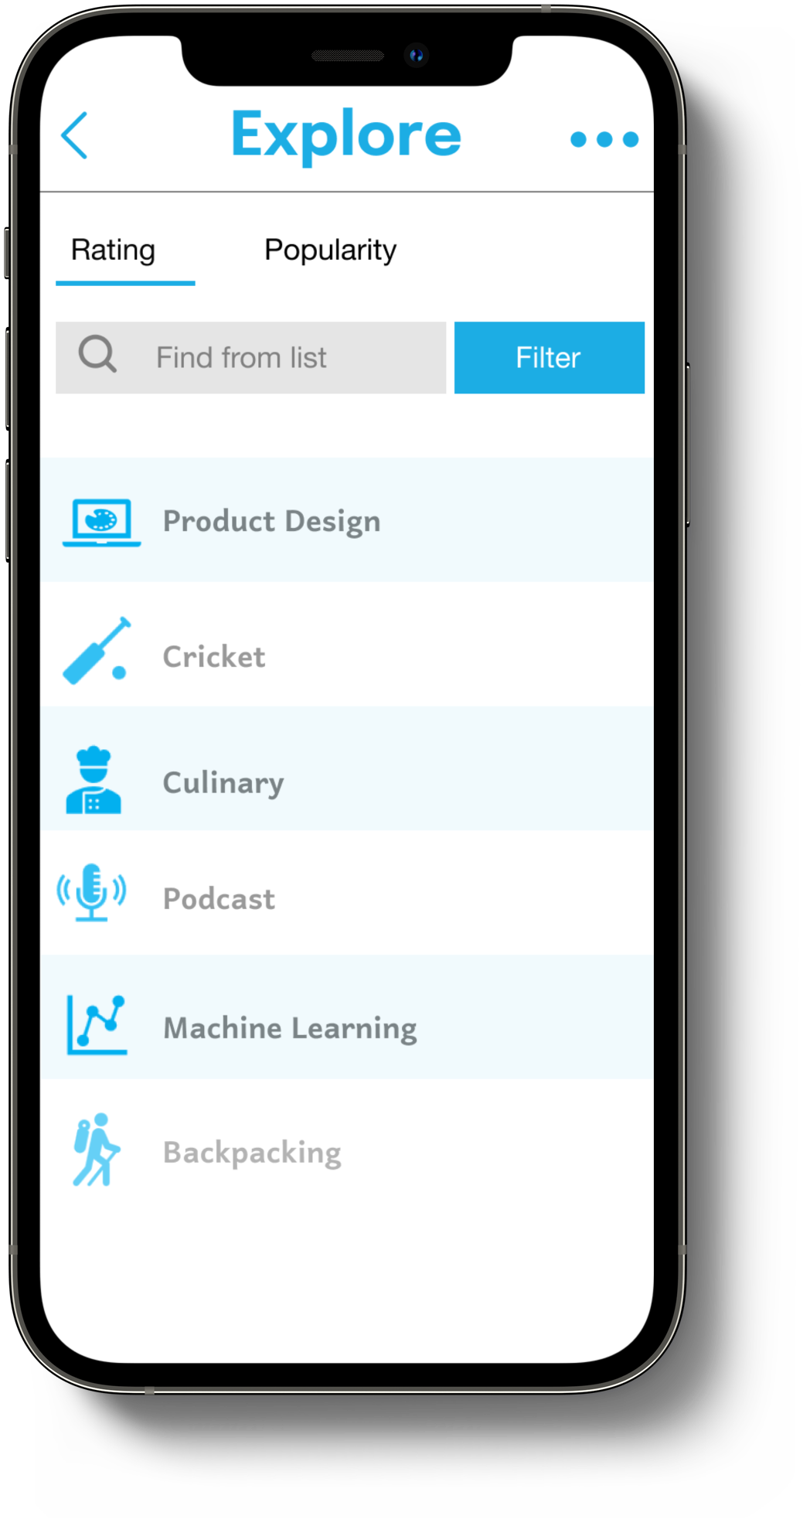
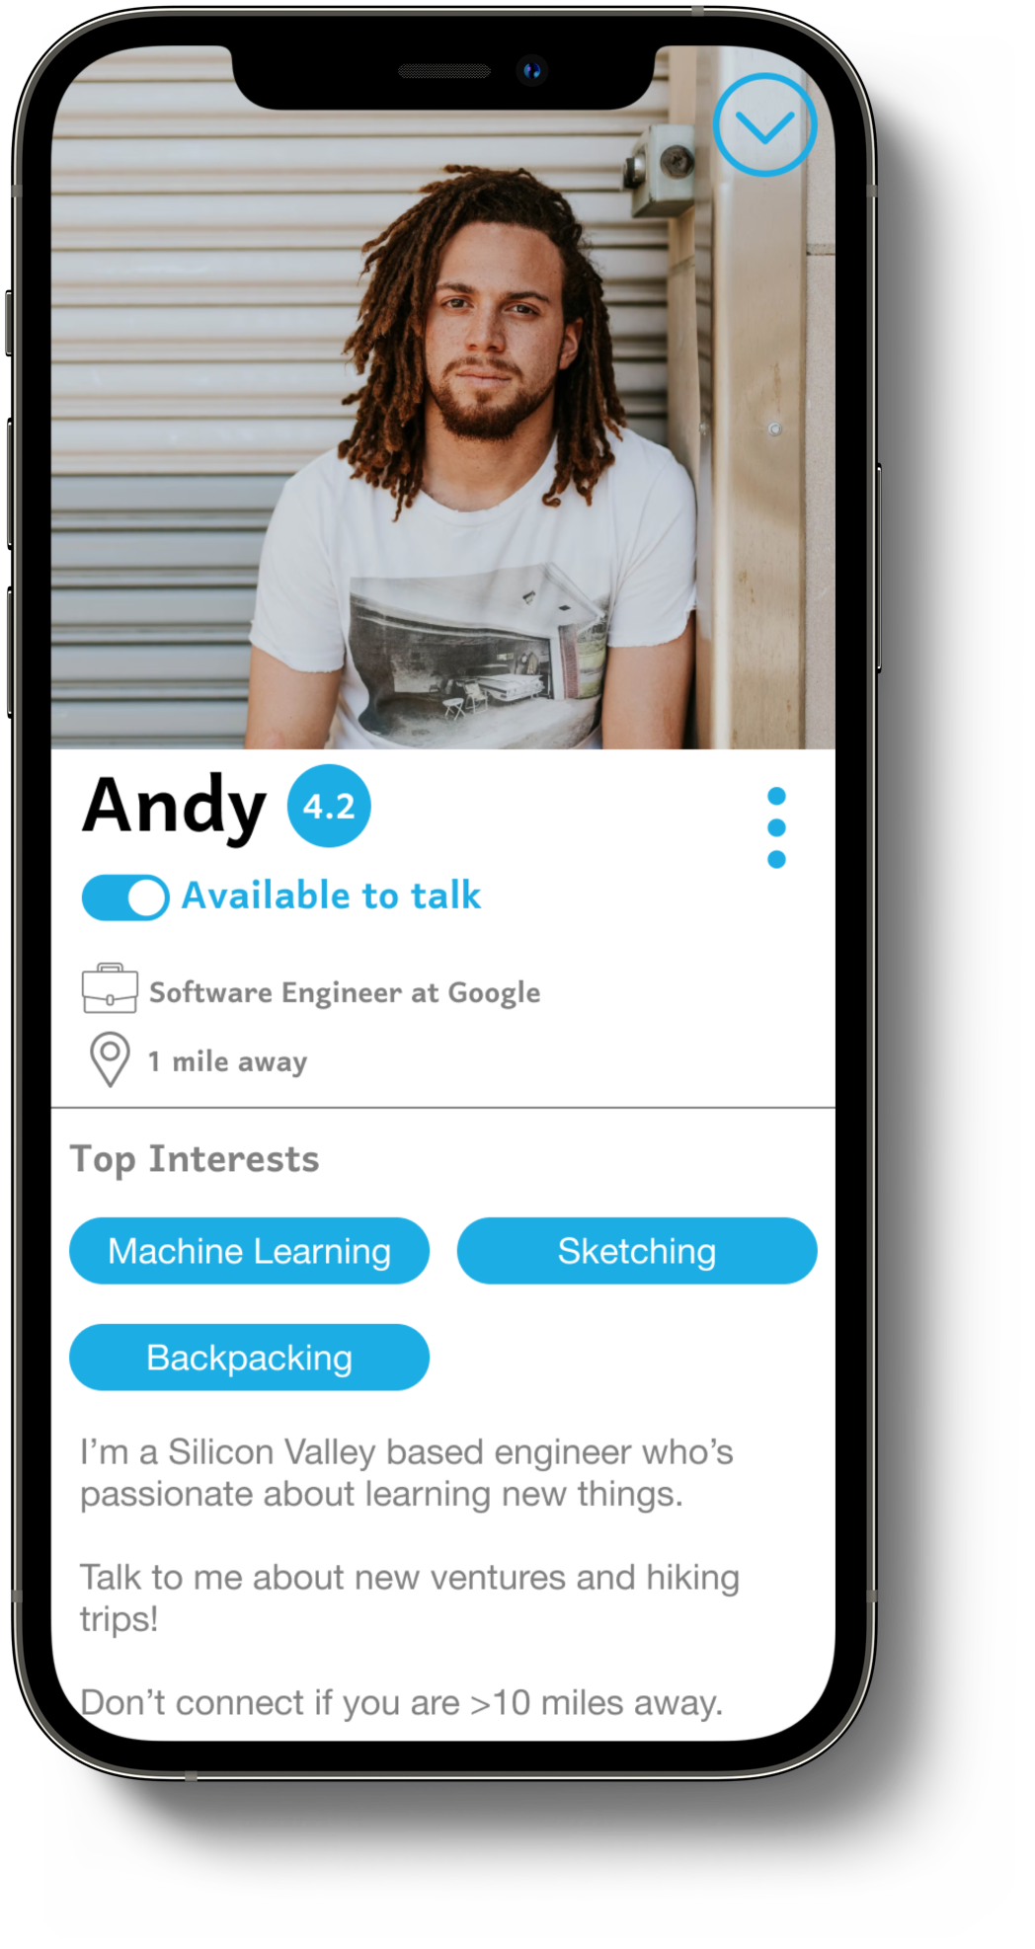
Sneak peek
Home
Explore an area of interest
Build your profile

Slide 7
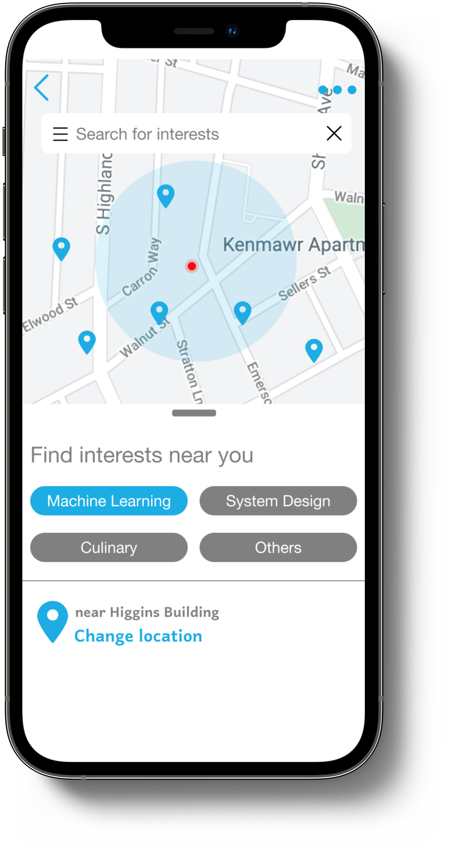
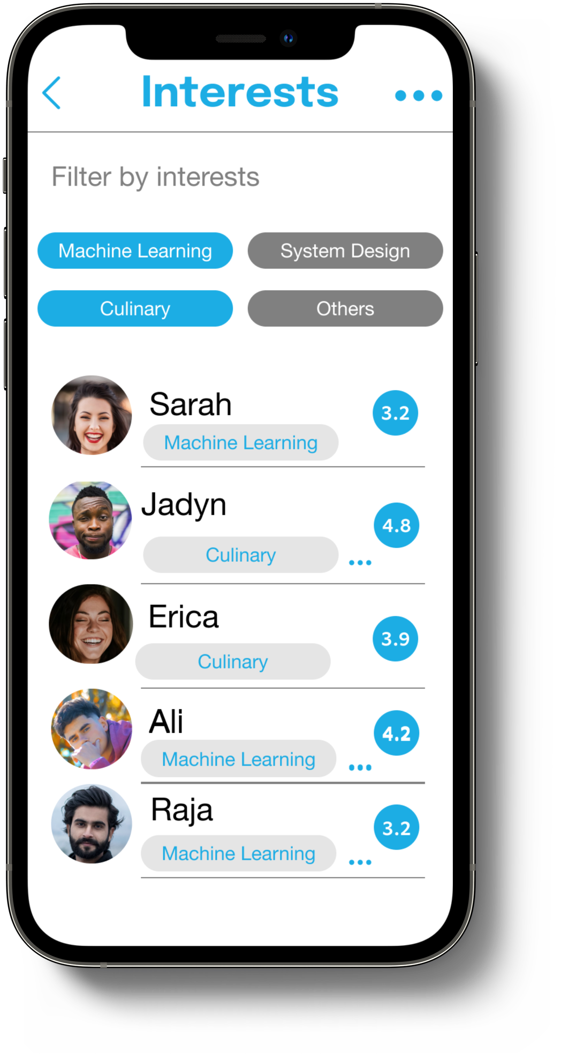
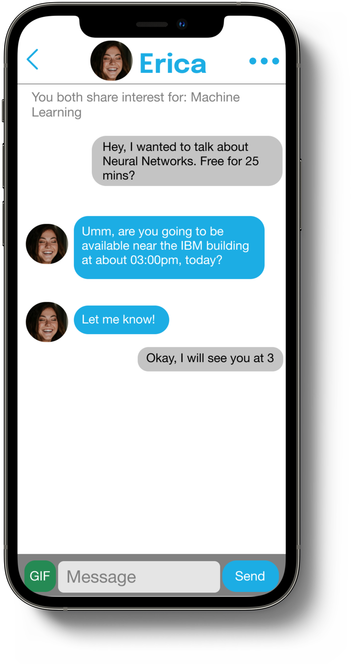
Sneak peek
Locate an interest match around you
Explore users with similar interest
Chat and schedule a meetup

Slide 8



Revenue Model
Precise Targeted Advertising
Hosted Events
Corporate Licensing
B2C
B2B

Slide 9

Projection
~15 Million Users
$150k
Annual AdSense Revenue
~900K Monthly Views
49 Million Users⁷ 2.87 Monthly Views⁷
~30% of Current Market
(5 Year Target)
Sources available in Appendix

Slide 10




Our Competition
Accurate talent aggregation for companies
Robust endorsement system
Flexible, instant, 1-1 connections
Introvert friendly
Feedback-driven network
Simple, direct, uncluttered conversations

Slide 11




Team Peeko
ABHINAAV SINGH
AKSHAY BAHADUR
CHIRAG HURIA
NAMAN AROA
4 years at Schlumberger as a Software Engineer LinkedIn
4 years as a Data Scientist LinkedIn
3 years at Deloitte as a Data Analytics Consultant
LinkedIn
3 years at Deloitte as a Consultant in Analytics & Regulatory Compliance
LinkedIn

Slide 12
Appendix
¹ https://www.thecut.com/2014/07/why-new-yorkers-should-small-talk-more.html
² https://www.cdc.gov/pcd/issues/2019/19_0017.htm
³ https://www.census.gov/newsroom/press-releases/2021/one-way-travel-time-to-work-rises.html
⁴ https://www.studyfinds.org/sign-of-the-times-75-of-adults-arent-friends-with-any-of-their-neighbors/
⁵ https://www.mckinsey.com/industries/technology-media-and-telecommunications/our-insights/the-social-economy
⁶ https://www.forbes.com/sites/thehartmangroup/2016/05/25/table-for-one-why-we-are-increasingly-eating-alone/?sh=539771b9616f
⁷ https://www.similarweb.com/website/meetup.com/

